Slide 1


AIML CA1 Classification: Part A
Name: Goh Yu Jie
Admin No.: P2415901
Class: DAAA/FT/1B/04

Slide 2
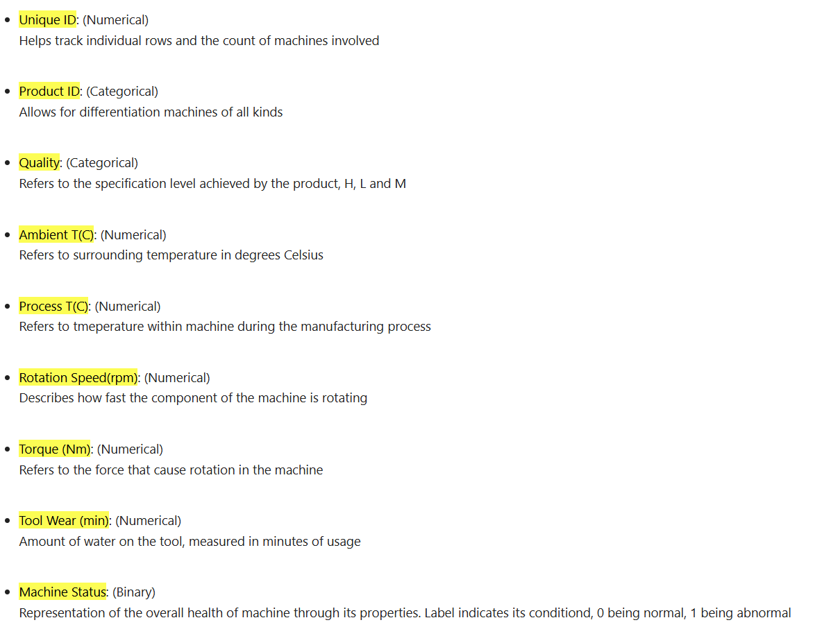

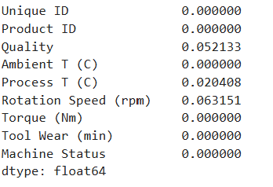
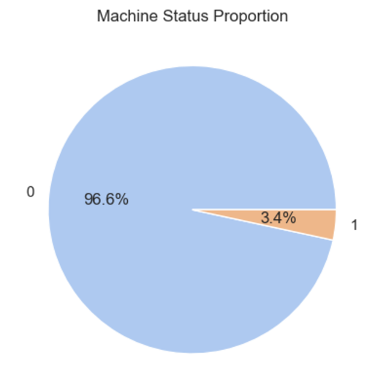

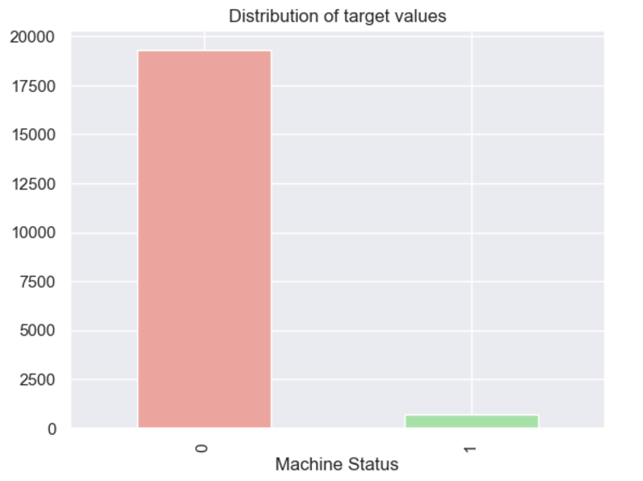
Exploratory Data Analysis
1) Meaning of all variables involved
2) Check for missing values
(in percentages) => Impute
3) Check for balance in target (must balance)
rows
columns

Slide 3
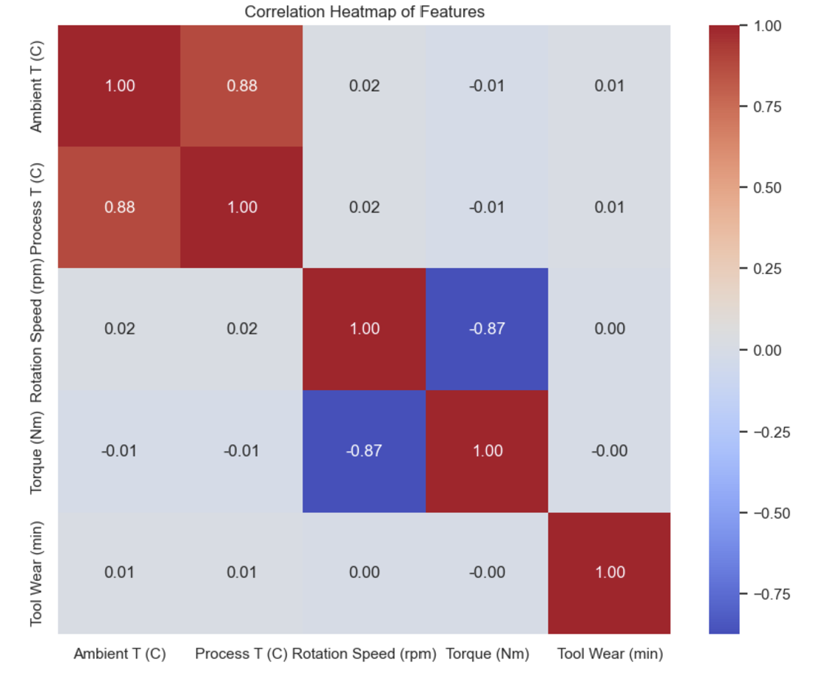
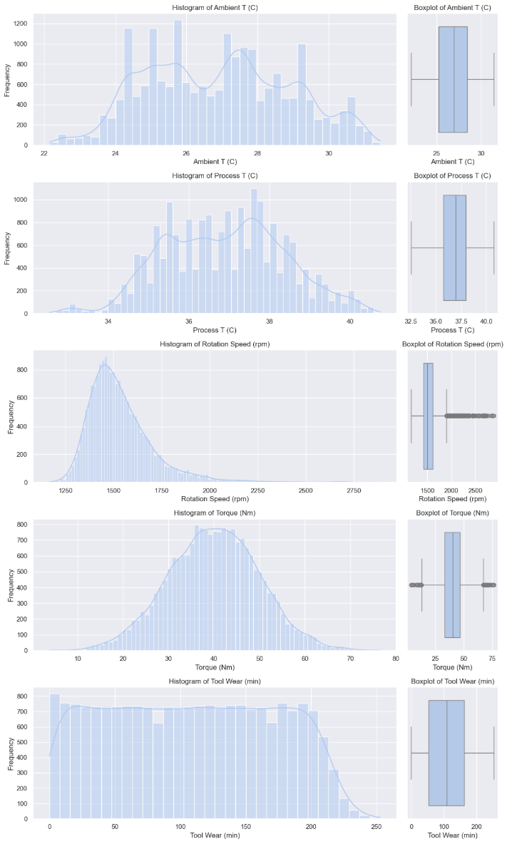
Correlations and skewness (EDA)
Skewness and outliers of numerical features (must transform standardize)
Heatmap to show correlations
Rotation Speed (rpm) and, to a lesser extent, Torque (Nm) have noticeable skewness
Transformations like log or square root might reduce skewness = inc. accuracy
The box plots highlight that Rotation Speed has the most significant outliers.
- high correlation between Ambient T(c) and Process T(c) (0.88) => Amb inc., process inc.
Standardization through robust or standard scalar will reduce outliers
- strong negative correlation between Rotation Speed (rpm) and Torque (Nm) (-0.87) => rpm inc. , Nm dec.
- low correlation among other feature pairs
(capture different aspects of data)

Slide 4
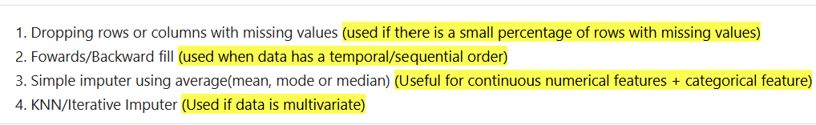
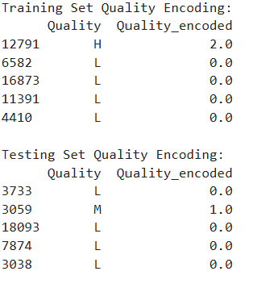


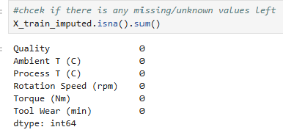
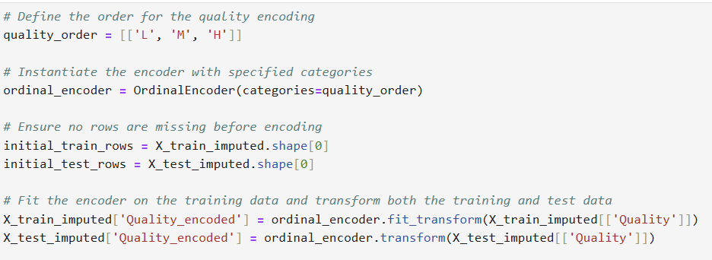
Data Preparation
1) Handling of unknown values.
2)Categorical encoding
3) Handle skewness

Slide 5
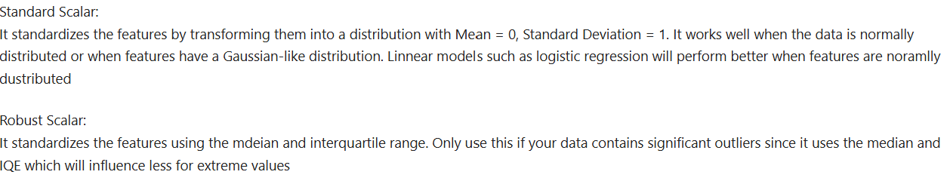
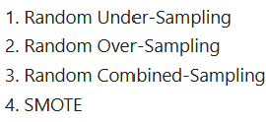

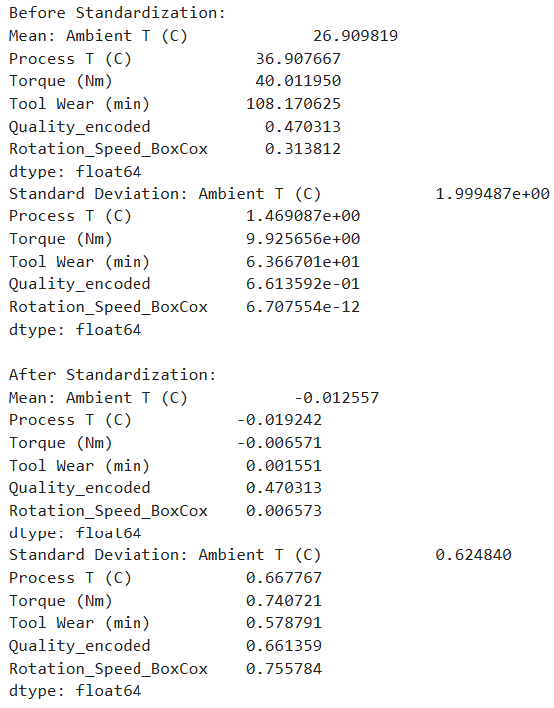

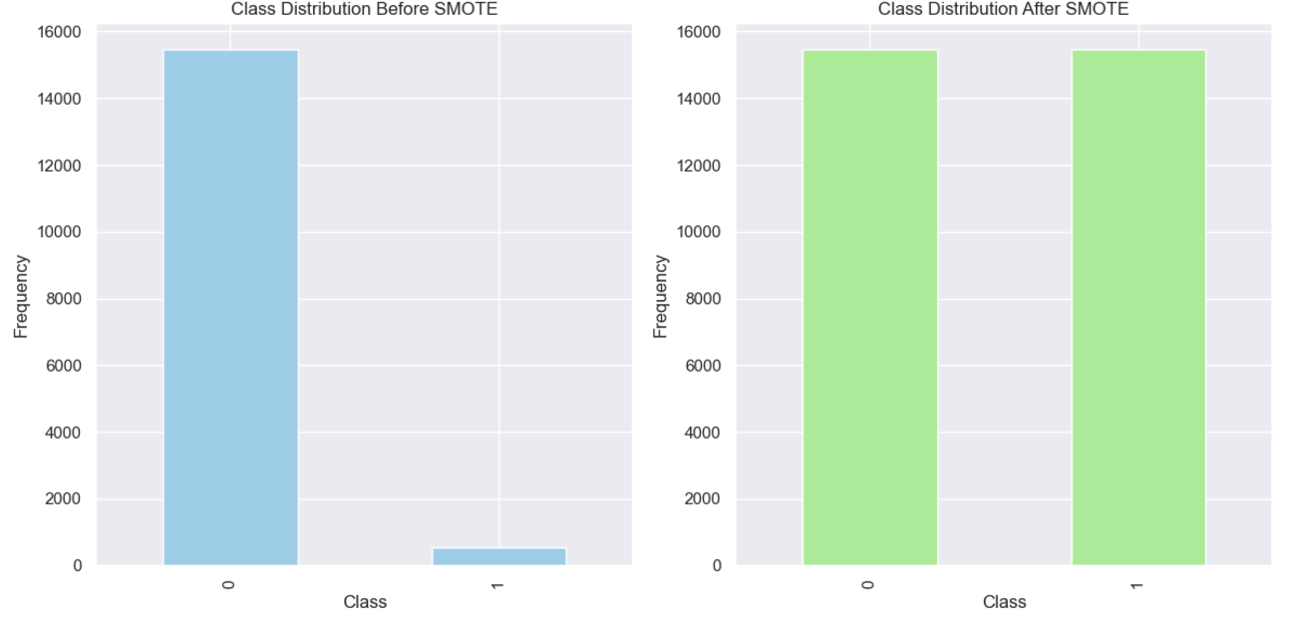
Data Preparation (2)
4) Handle outliers
5) Balance target

Slide 6
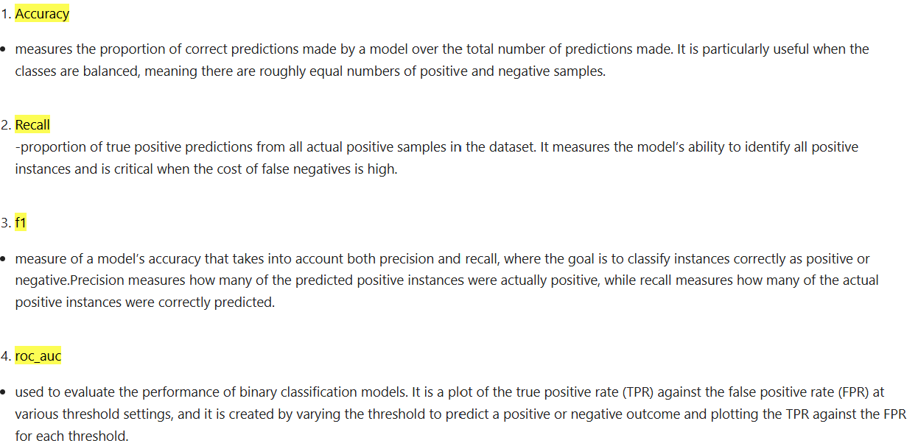
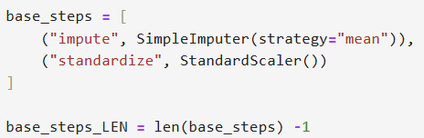
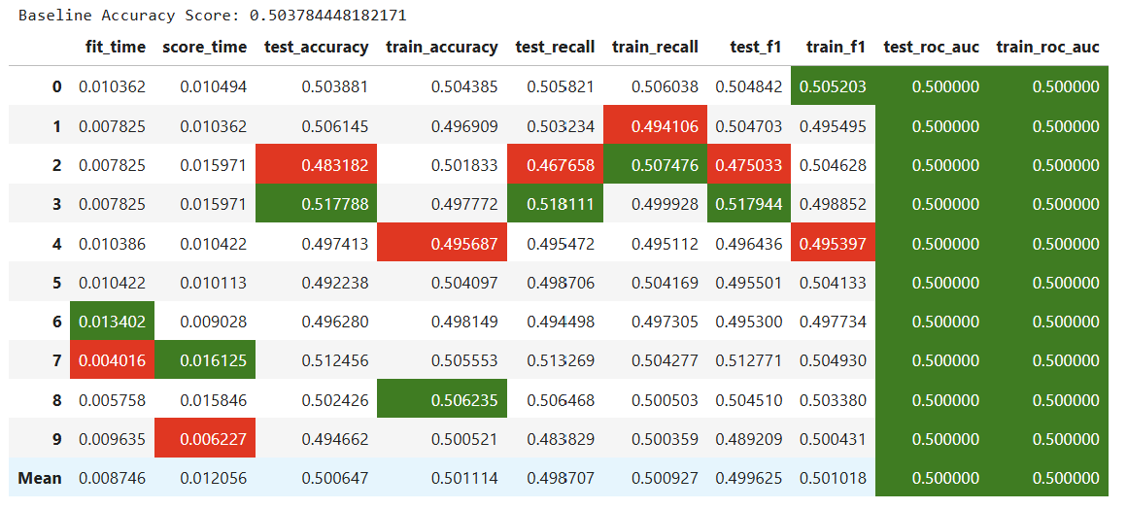
Model pipeline and training
Scoring methods/metrics
1) Creation of pipeline
2) Creation of dummy
This pipeline ensures that all the preprocessing steps are applied in sequence, followed by the model training process.
We will also employ the 4 metrics that will measure and determine the effectiveness of our model through providing insights into different elements of model performance

Slide 7
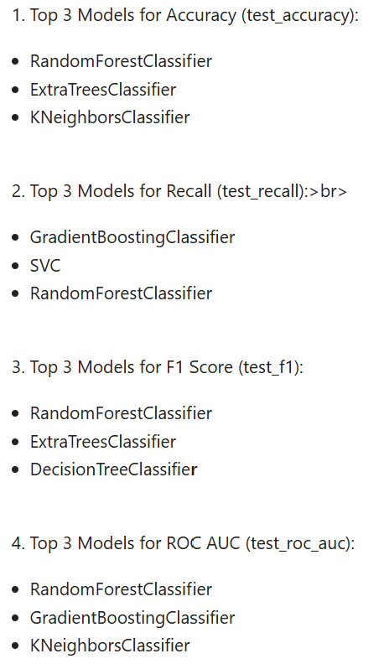
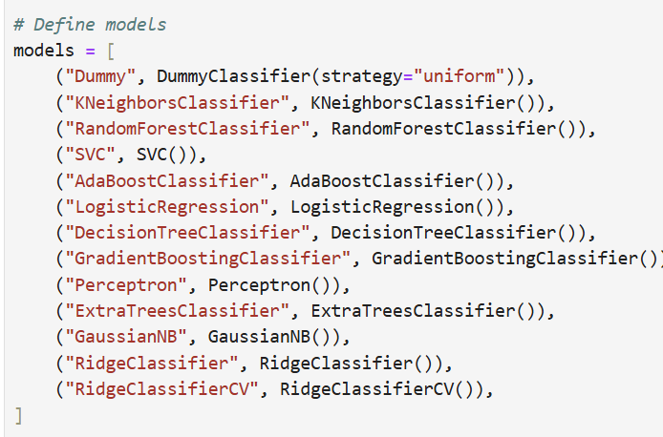
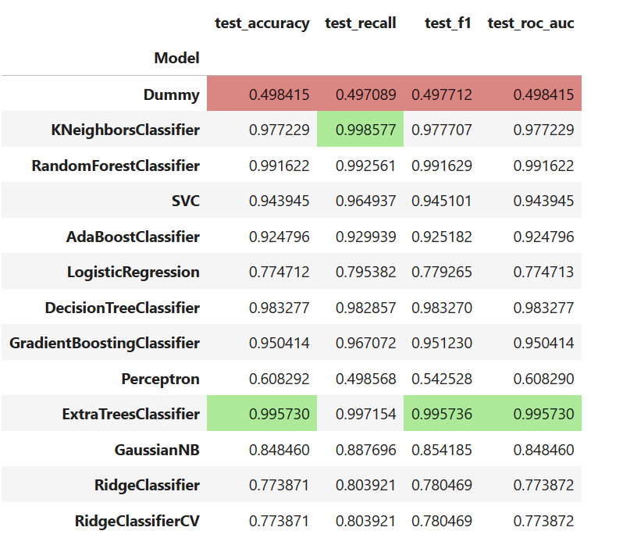
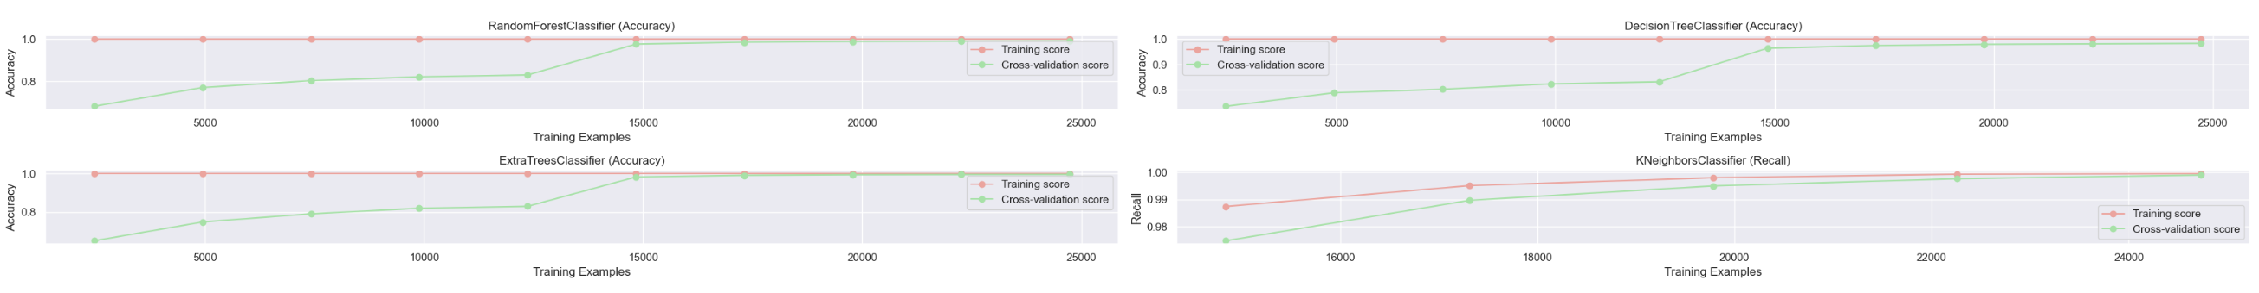
Model pipeline and training (2)
3) Models declared
4) Performances
In conclusion, ExtraTreesClassifier is likely the best overall model for your dataset based on its consistent high performance across all metrics. RandomForestClassifier is also highly competitive especially with its high recall score. KNeighborsClassifier also offers good recall score but is not as strong in recall or F1, meaning it might struggle with detecting all positive class instances.

Slide 8
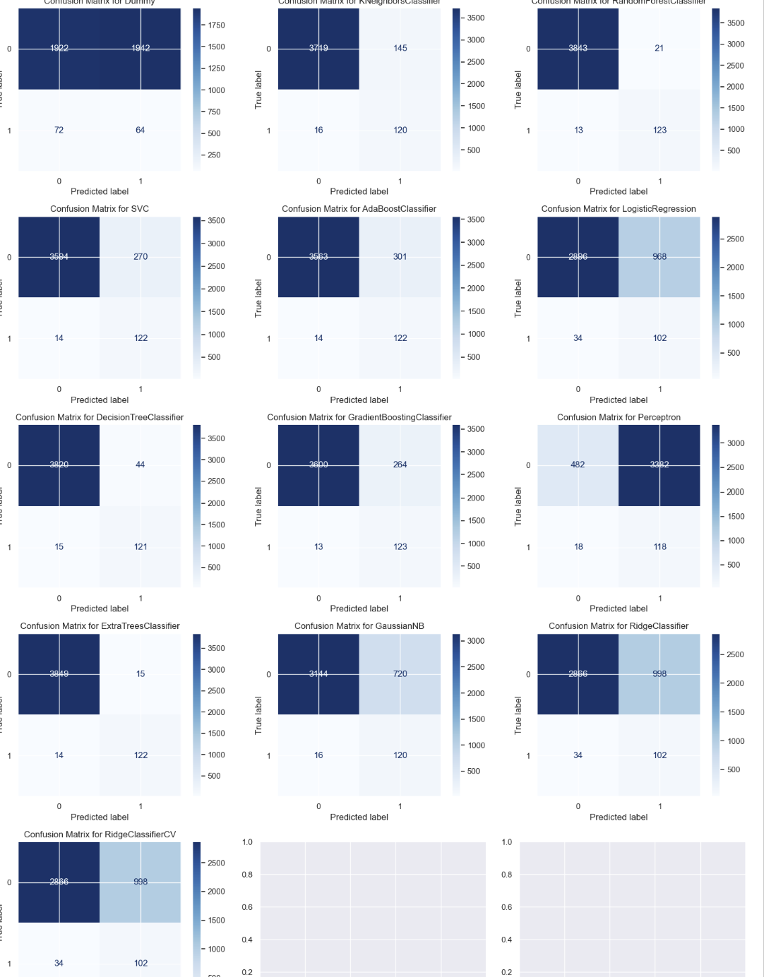
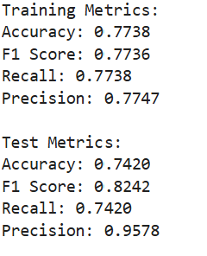
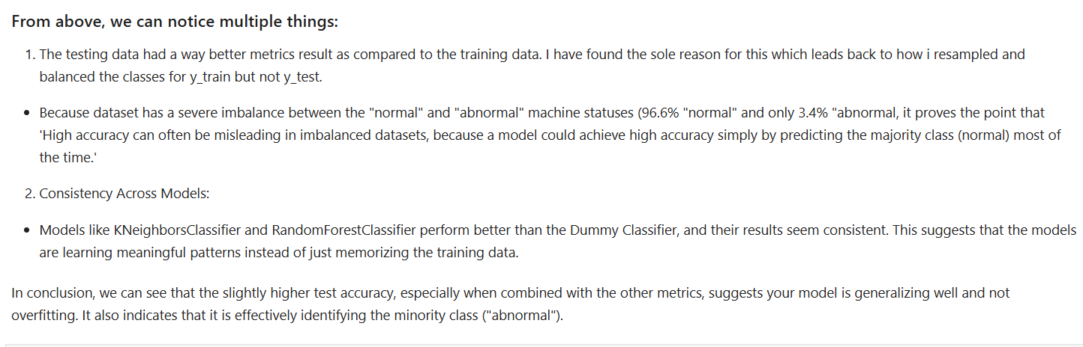
Check for overfitting
2) Evaluating confusion matrix
1) Comparing metrics between train and test

Slide 9
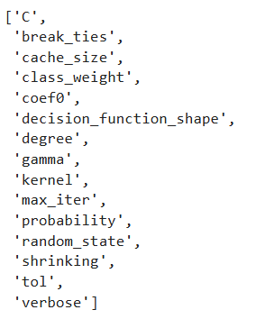
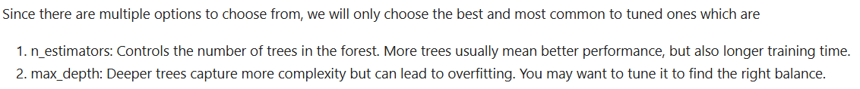
Hyperparameter tuning
1) Choosing parameter to tune
2) Tuning the parameters using Grid Search Cv

Slide 10
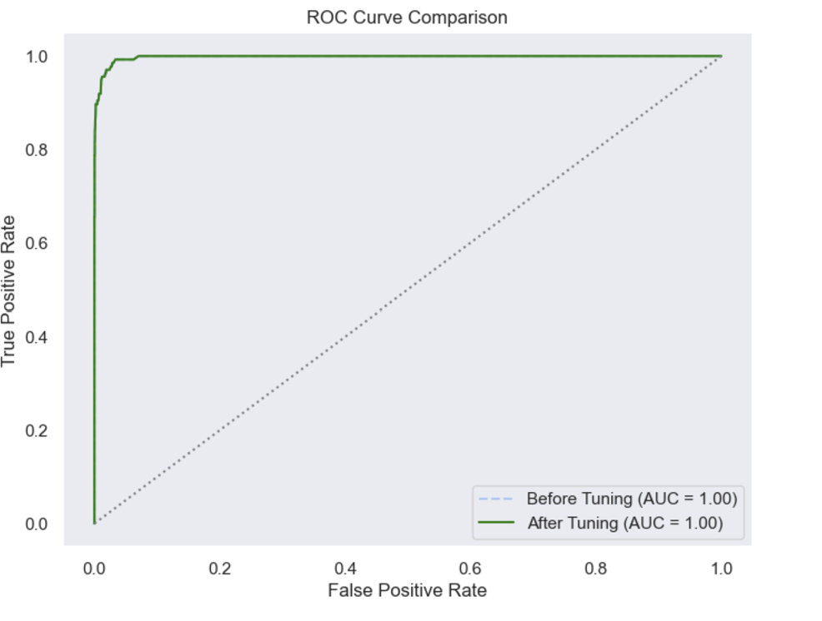
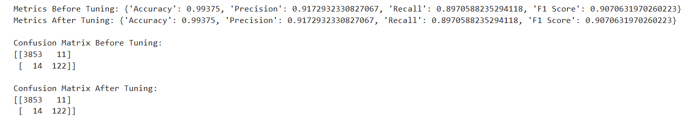
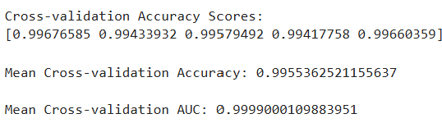
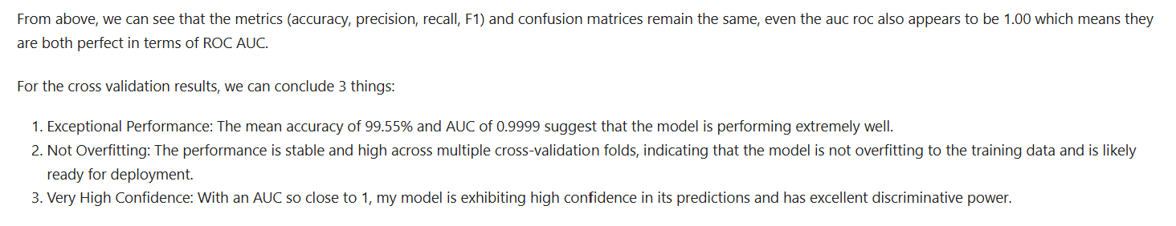
Hyperparameter tuning (2)
3) Comparison of metrics before and after
4) Plot for roc comparison
5) Model Evaluation with Cross-Validation

Slide 11
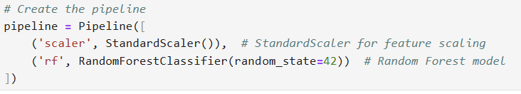
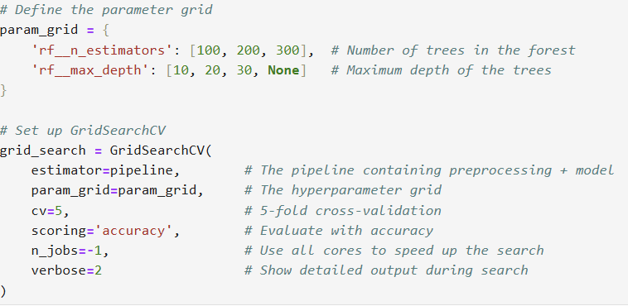
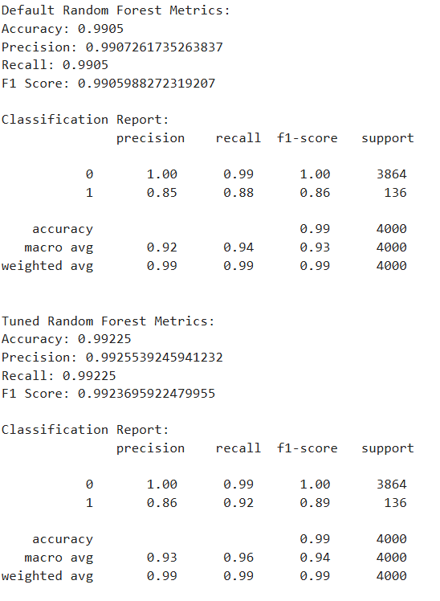
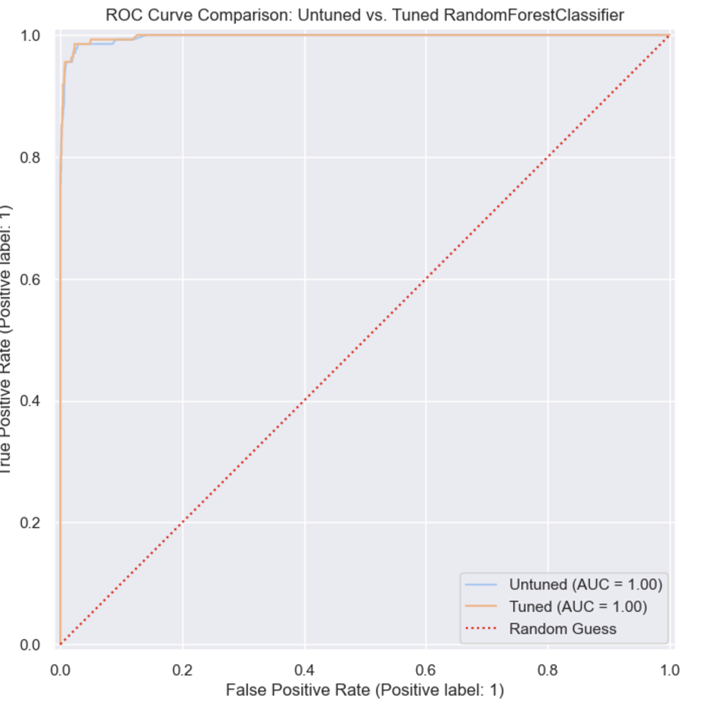
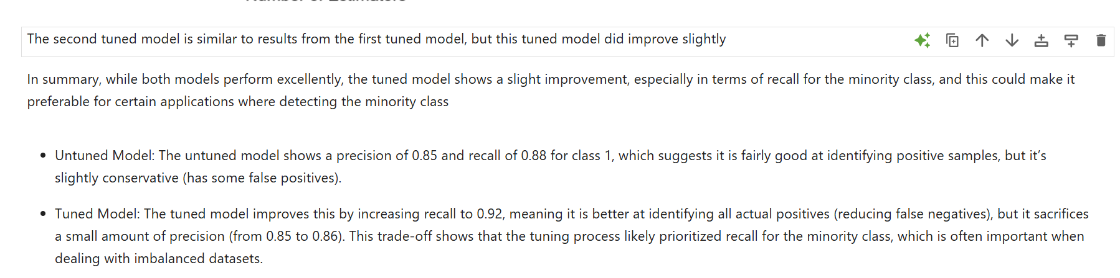
Hyperparameter tuning (second model)

Slide 12
Conclusions:
Top performers
Good performers
Lower performers
(ExtraTreesClassifier, RandomForestClassifier, KNeighborsClassifier)
(DecisionTreeClassifier, GradientBoostingClassifier, SVC)
(Logistic Regression, Ridge Classifier, RidgeClassifierCV)
- Extra Trees and Random Forests: These are ensemble methods that aggregate the results of multiple decision trees to improve robustness and accuracy. They reduce overfitting by averaging the predictions of many trees.
- DecisionTreeClassifier: Simple and interpretable but can overfit if not pruned.
- Logistic Regression: Assumes a linear decision boundary. Effective for simple problems but may struggle with non-linear relationships.
- GradientBoostingClassifier: Sequentially builds models to correct errors of previous models. It’s powerful for complex patterns but requires careful tuning.
- Ridge Classifier and RidgeClassifierCV: Like Logistic Regression but include L2 regularization. Performance is comparable to Logistic Regression.
- KNeighborsClassifier: Effective for capturing local structures in the data. Works well when there is a clear distinction between classes.
- SVC (Support Vector Classifier): Effective in high-dimensional spaces. Uses kernel functions to capture non-linear boundaries but can be computationally intensive.

